Slide 1

Chapter 4: Privacy, Anonymity, and Data Protection

Slide 2

Discussion 4.1: is there true privacy in the digital world?

Slide 3

Privacy
Privacy is an evolving concept.
The matters that have been considered public and private have evolved because of changing attitudes, institutions, living conditions, and technology.
What we consider private today is shaped by culture and time and differs across societies.

Slide 4
Evolution of Privacy
1890
The Right to be left alone
1950 Universal Declaration of Human Rights
1984 UK Data Protection Act
1974 Fair Information Practice and US Federal Privacy Act
2003 Japanese Act on the Protection of Personal Information (APPI)
2014 EU Court of Justice “Right to be forgotten” decision
2017 EU GDPR

Slide 5
Solove’s Taxonomy of Privacy
The taxonomy of privacy is a structured framework designed to categorize and define various types of privacy-related problems and harms.
Developed by Daniel Solove, it identifies specific activities and practices that violate privacy, rather than treating privacy as a single, vague concept.
The taxonomy divides privacy violations into four main categories: information collection, information processing, information dissemination, and invasion.

Slide 6
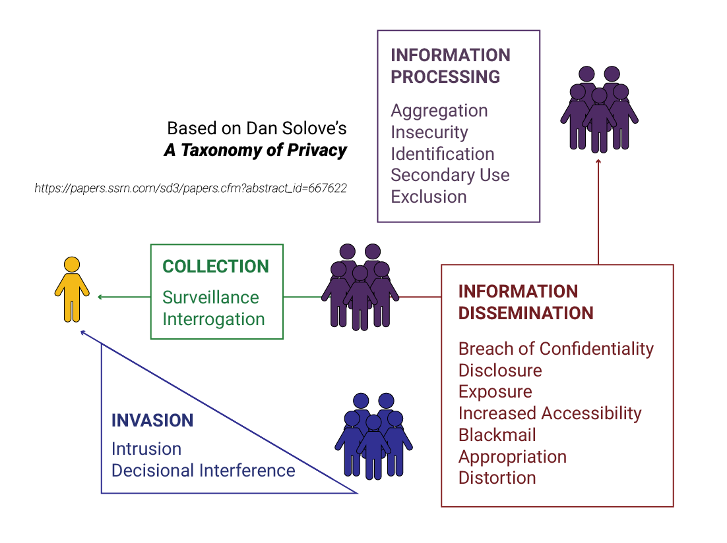
Solove’s Taxonomy of Privacy

Slide 7

Information Collection
Surveillance: Watching, listening to, or recording an individual’s activities, leading to discomfort, inhibition, and loss of freedom.
Example: A company uses hidden cameras in a workplace to monitor employees without their knowledge.
Interrogation: Pressuring individuals to divulge information, which may be invasive or coercive.
Example: A health insurance provider pressures applicants to disclose sensitive medical history irrelevant to their policy.

Slide 8

Information Processing
Aggregation: Combining various data points about a person to create a comprehensive profile, often used without consent.
Example: A marketing firm combines data from social media, online purchases, and location tracking to create detailed consumer profiles.
Identification: Linking collected data to specific individuals, leading to potential misuse.
Example: An anonymous user’s data is linked to their identity through IP address tracking, exposing their online activities.

Slide 9
Information Processing
Insecurity: Failing to safeguard data, leading to unauthorized access or leaks.
Example: A database containing sensitive customer information is left unencrypted and is accessed during a data breach.
Secondary Use: Using collected data for purposes other than originally intended without the individual's consent.
Example: A fitness app collects data for health tracking but sells it to advertisers without users’ consent.
Exclusion: Preventing individuals from accessing or controlling the data collected about them.
Example: A credit agency refuses to provide a person access to their credit report or explain how their credit score was calculated.

Slide 10

Information Dissemination
Breach of Confidentiality: Breaking promises to keep personal information private.
Example: A therapist shares a patient’s confidential details with a third party without consent.
Disclosure: Sharing truthful but potentially damaging personal information.
Example: A news outlet publishes the name of a private individual involved in a public scandal.
Exposure: Revealing highly private aspects like family issues, bodily dysfunctions, or grief.
Example: A hacker leaks private photos of a celebrity online.

Slide 11
Information Dissemination
Increased Accessibility: Amplifying access to personal data, making it more vulnerable to misuse.
Example: A public database makes sensitive court records easier to access, exposing individuals to stigma or harassment.
Blackmail: Threatening to disclose personal information unless demands are met.
Example: An individual threatens to release compromising information about someone unless they pay money.

Slide 12
Information Dissemination
Appropriation: Using someone's identity or personal data for another's benefit.
Example: A company uses a person’s likeness in advertisements without obtaining their permission.
Distortion: Disseminating false or misleading information about individuals.
Example: False information about a person’s behavior is spread on social media, damaging their reputation.

Slide 13

Invasion
Intrusion: Disrupting an individual's solitude or seclusion.
Example: A landlord installs cameras inside a tenant’s apartment without permission.
Decisional Interference: Government or organizational intrusion into personal decisions.
Example: A government bans certain personal medical procedures, interfering with individuals’ decisions about their health.

Slide 14
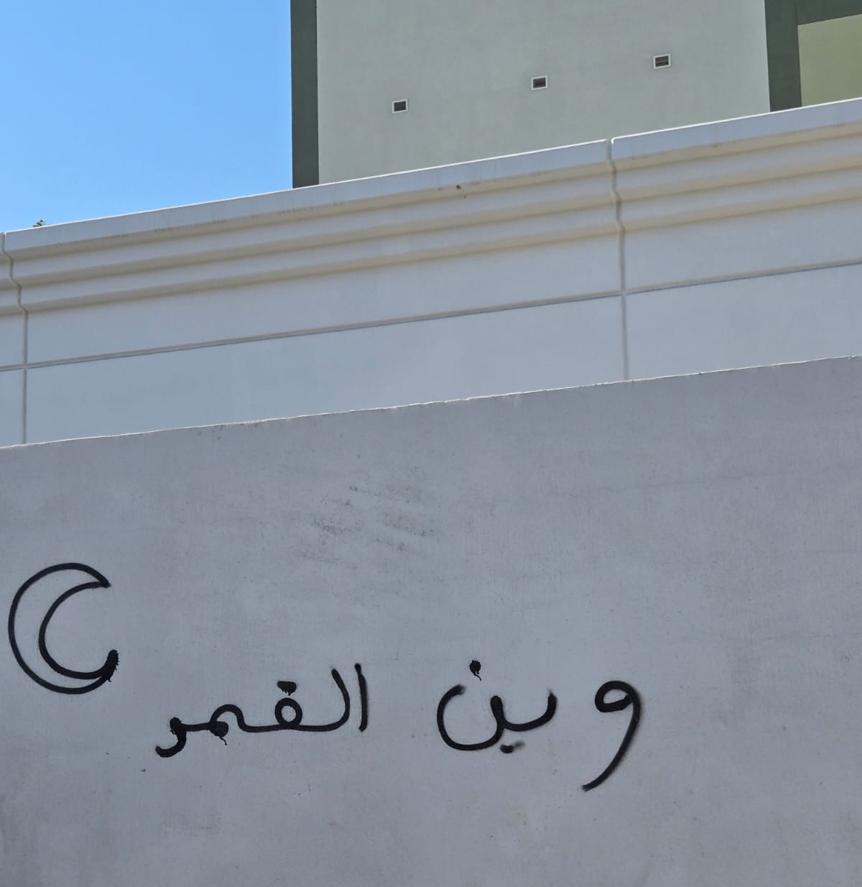
Anonymity
Notes:
Ask about who could be the “artist”? Their characteristics, name, age, location,

Slide 15

Anonymity
According to Kathleen Wallace, anonymity is the noncoordinability of traits in a given respect.
This means that a person is considered anonymous when others cannot connect a known trait (an action, characteristic, or identifier) to other identifiable traits of the individual, such as:
Name, age, address, IP address, etc.

Slide 16
Anonymity
Anonymity is not merely about being unknown; it is about severing or shielding the connections between traits that would enable identification.
Example: Wearing a disguise, using a voice changer, using a VPN

Slide 17
Types of Anonymity
Wallace identifies three primary types of anonymity based on their purposes and the contexts in which they arise:
Agent Anonymity
Recipient Anonymity
Process Anonymity

Slide 18
Agent Anonymity
Agent anonymity refers to anonymity that enables or furthers actions by the anonymous person. In this case, anonymity allows the individual to act without their identity being known or associated with the action.
Examples:
Anonymous authorship: Writers may publish work without attribution to freely express ideas without fear of personal or professional consequences. Historical examples include George Eliot, who used a pseudonym to avoid the gender bias of the time.
Anonymous donors: Individuals may choose to donate to charities or causes without public recognition, preserving their privacy or avoiding unwanted attention.
Criminal actions: In a more negative light, the anonymity of figures like the Unabomber enabled illegal activities by shielding their identity from law enforcement.

Slide 19
Recipient Anonymity
Recipient anonymity protects an individual from actions by others, such as discrimination, stigmatization, or harm. Here, the anonymity primarily benefits the person by shielding them from potential repercussions related to their identifiable traits.
Example
Whistleblowers: Employees or insiders who expose unethical or illegal activities within organizations often rely on anonymity to protect themselves from retaliation, such as job loss or harassment.

Slide 20
Process Anonymity
Process anonymity ensures the fairness, impartiality, or integrity of a specific process. This type of anonymity is often designed to prevent bias or undue influence within systems or procedures.
Examples:
Blind peer reviews: Anonymity between authors and reviewers in academic publishing ensures unbiased evaluations based solely on the merit of the work.
Anonymous juries: Shielding the identities of jurors can protect them from external pressures or threats, promoting unbiased deliberations.

Slide 21
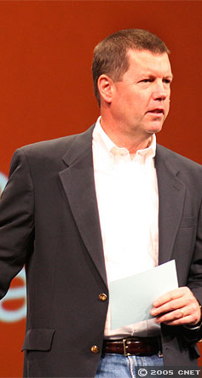
Data Protection
“You have zero privacy anyway. Get over it”
Scott McNealy, Former CEO of Sun Microsystems

Slide 22

Data Protection
Data protection is defined as the framework of laws, policies, procedures, and technologies designed to safeguard personal data from:
Unauthorized access
Misuse
Breaches
Giving individuals control over their information

Slide 23

Data Protection as a Fundamental Right
The European Union’s Charter of Fundamental Rights’ Article 8 states: Everyone has the right to the protection of personal data concerning him or her.
This right laid the foundation of the creation of the EU’s General Data Protection Regulation (GDPR) and many similar regulations across the globe

Slide 24

Data Protection Challenges: Policy
Post 9/11, data protection principles have been systematically weakened in the name of national security and market efficiency.
The Patriot Act in the United States enabled extensive surveillance and data collection through agencies such as the NSA.

Slide 25
Data Protection Challenges: Technology
Rapid advancements in technology have created tools that can classify, profile, and control individuals, undermining core data protection principles such as:
Surveillance technologies: Biometric recognition, AI-driven monitoring systems erode privacy and autonomy
Social Sorting: Technologies are increasingly used to categorize people for commercial, political, or security purposes, potentially leading to discrimination.
Big Data Analytics: Vast datasets allow organizations to infer sensitive details about individuals, even if the data appears anonymized

Slide 26
Privacy, Anonymity, and Data Protection
Aspect | Privacy | Data Protection | Anonymity
Definition | The right to control access to one’s personal information and make decisions about its use. | The safeguarding of personal data from unauthorized access, misuse, or breaches. | The state of being unidentifiable or untraceable in a particular context.
Focus | Protecting individual rights and autonomy over personal information. | Securing data to prevent breaches or unauthorized use. | Concealing the identity of an individual.
Scope | Broad: Includes informational, physical, and communication privacy. | Narrower: Focused on securing personal data. | Specific: Focused on identity concealment.
Responsibility | Shared between individuals and organizations handling personal data. | Primarily organizations and regulators that collect/process data. | Primarily the individual seeking anonymity.

Slide 27
Privacy, Anonymity, and Data Protection
Aspect | Privacy | Data Protection | Anonymity
Key Concerns | Consent, transparency, and how data is collected, shared, and used. | Preventing data breaches, unauthorized access, and ensuring compliance. | Ensuring no link exists between identity and actions or information.
Implementation | Policies like privacy settings, informed consent, and ethical data handling. | Security measures like encryption, firewalls, and data access controls. | Tools like pseudonyms, VPNs, and Tor for masking identity.
Traceability | Traceability may exist if individuals consent to share data selectively. | Traceability depends on security measures but is not the primary focus. | Traceability is minimized or eliminated.
Purpose | Protect the individual's personal space and data boundaries. | Protect the integrity and confidentiality of data. | Protect the individual's identity in communications or activities.

Slide 28
Summary
Privacy is historically and culturally variable.
Solove’s taxonomy shows how harm occurs through collection, processing, dissemination, and invasion.
Anonymity can enable freedom, fairness, and protection, but also abuse.
Data protection emerged as a response to surveillance and profiling.
Critical Reflection
Is true privacy possible in digital societies?
When does anonymity become ethically unjustifiable?

